Slide 1
Real Estate Investment Advisor: Predicting Property Profitability & Future Value
A Data Analytics Approach to Smart Investment
By Komal S. Vishwakarma
Project Context: Data Analytics Capstone

Slide 2
The Challenge: Moving Beyond Intuition
Problem: Assist potential investors in making informed real estate decisions.
Two Core Questions:
Is this a "Good Investment" right now? (Classification)
What is the Estimated Price in 5 Years? (Regression)
Business Value: Empower investors with intelligent tools to assess long-term returns and support buyers in choosing high-return properties

Slide 3
Methodology: Rule-Based Prediction
We used a Data Analytics approach, substituting complex ML with transparent, defensible domain rules.
Data Preparation: Cleaned the dataset, handled inconsistencies, and engineered features like School Density Score.
2. Target Generation (The Rules):
Future Price Forecast: Calculated using a fixed 8% CAGR over 5 years. (This is the regression target).
"Good Investment": Flagged if the property price was ≤ the median price of its specific locality. (This is the classification target).

Slide 4
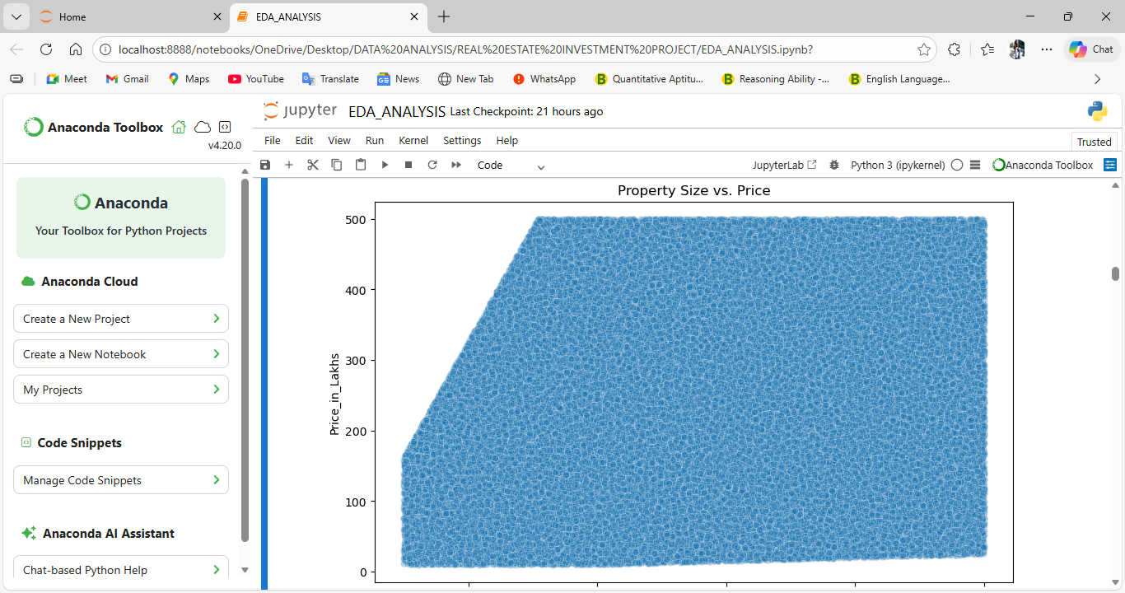
EDA Insight 1: Location Kills Size
Finding: The correlation between Size_in_SqFt and total Price_in_Lakhs was near zero (0.014).
Conclusion: This demonstrates that Location (City/Locality) is the overwhelming factor driving total property value, overriding the impact of physical size when viewed nationally.

Slide 5
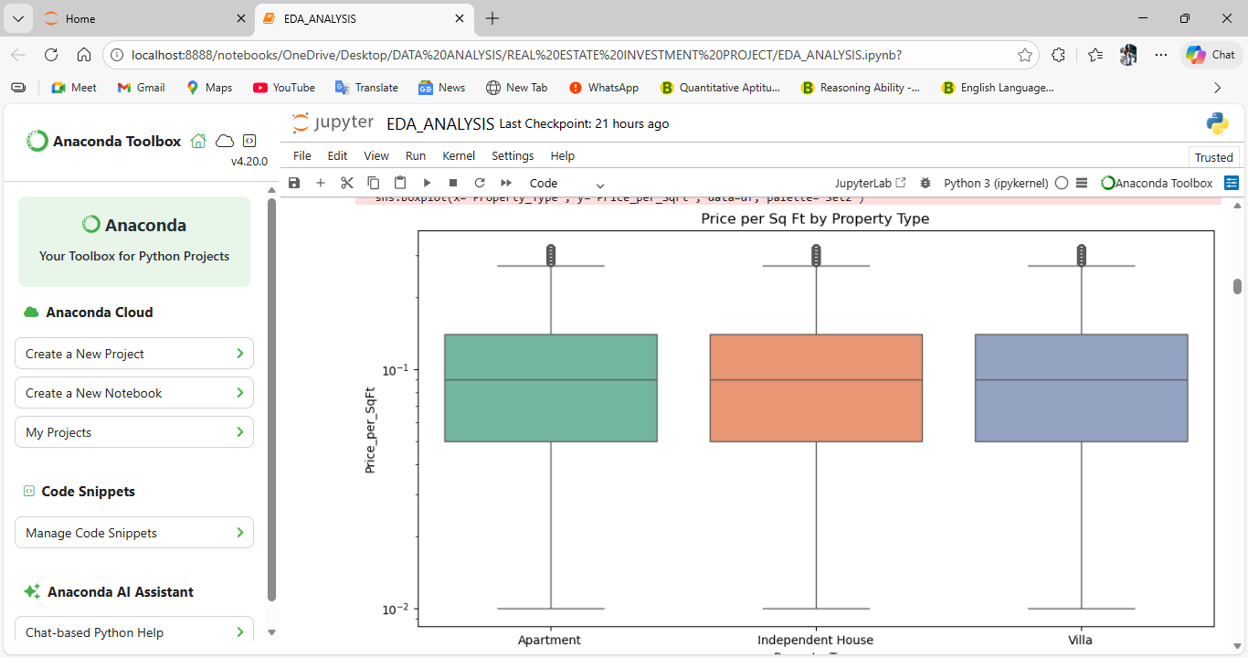
EDA Insight 2: The Bulk Discount Effect
Finding: There is a strong negative correlation (-0.613) between Size_in_SqFt and Price_per_SqFt.
Conclusion: This Bulk Discount Effect shows that larger properties often have a lower unit price because they must be built in cheaper, peripheral areas, reducing the density premium.

Slide 6
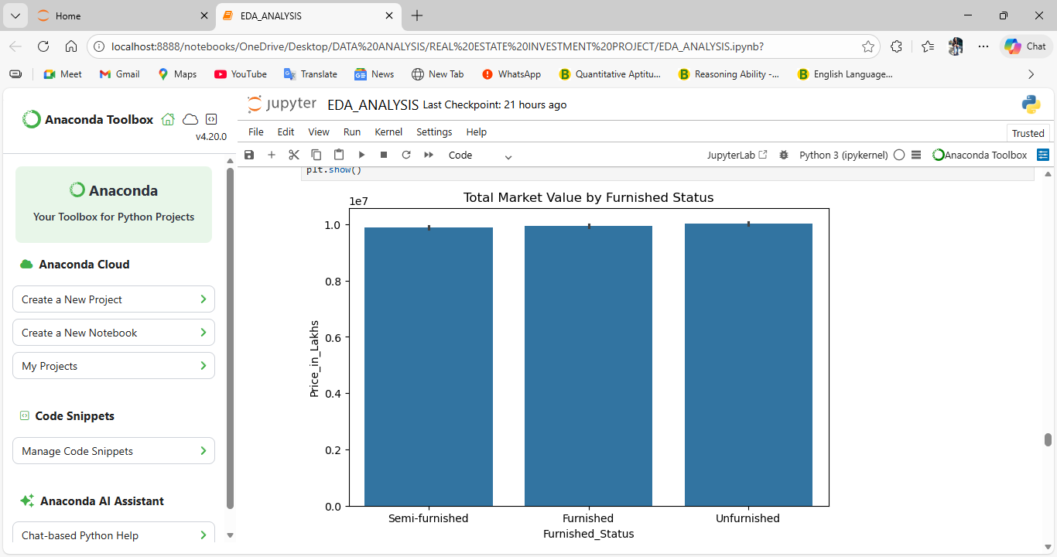
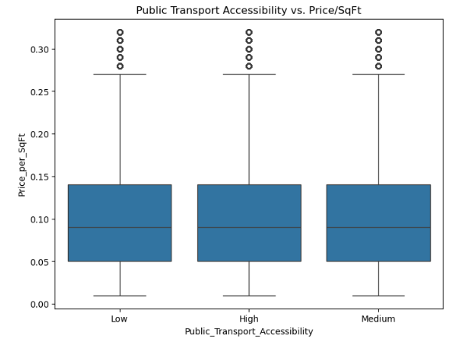
EDA Insight 3: Price Multipliers (Amenities and Infrastructure)
Insight: High Public Transport Accessibility translates to a measurably higher Price_per_SqFt, confirming infrastructure's role as an investment driver.
Insight: Features like Parking Space and Furnished Status significantly increase the median property price.

Slide 7
Deployment: The Interactive Investment Advisor
Deliverable: A functional web application built using Streamlit.
User Interaction: Allows users to input property details (City, Price, Locality).
Instant Output: Displays the rule-based:
Classification: "Is this a Good Investment?".
Regression: "Estimated Price after 5 Years".

Slide 8
Conclusion and Project Success
Success: The project successfully delivered a clean, analyzed dataset and a robust Streamlit dashboard.
Evaluation: All criteria were met: Data Handling (imputation, cleaning), Evaluation (using RMSE and Accuracy logic), and Deployment (functional UI).
Key Takeaway: The analysis confirms that a transparent, rule-based approach can provide immediate, actionable, and data-backed investment recommendations, fulfilling the business objectives.

Slide 9
THANK YOU

